Slide 1




#yellow4flavi
Colombia
Funded by the European Union. Views and opinions expressed are however those of the author(s) only and do not necessarily reflect those of the European Union or European Health and Digital Executive Agency (HaDEA). Neither the European Union nor the granting authority can be held responsible for them.

Slide 2
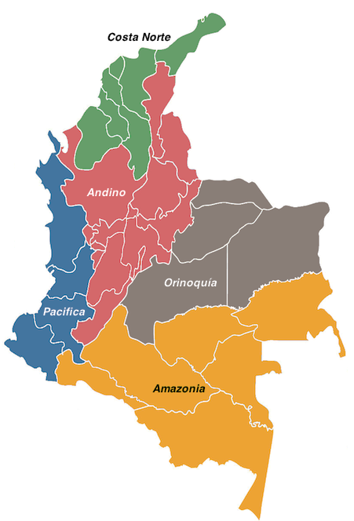
FIELDWORK LOCATION
#yellow4flavi
Fieldwork is being conducted across all five regions: in non-endemic areas of two regions and endemic areas of three regions.
In each region, 2 focus groups and 1 interview are conducted.
So far, fieldwork has been conducted in non-endemic areas.
Andean region – Bogotá
Pacific region – Cali
Caribe

Slide 3
PARTICIPANTS
51 participants have already taken part in face-to-face interviews and focus groups.
18–73 years old was the age range of the participants.
69% of participants were women.

Slide 4
FINDINGS
Underlined = high concentration
Italic = medium concentration
Normal text = low concentration
*, ** and *** denote codes with more than 50, 75, and 100 cites, respectively.

Slide 5
PRELIMINARY CONCLUSIONS

Slide 6

HEALTH SYSTEM
Despite efforts in promotion vaccines, yet access barriers persist.
Fear appears to be a distinctive feature in Colombian vaccination policies.
Mandatory and coercive approaches, especially during COVID-19, caused public discomfort.
There’s a need to improve vaccine promotion through better education and communication strategies.

Slide 7

PERCEPTIONS
Participants recognize vaccines’ benefits, especially for childhood protection.
Risk perception about side effects vaccine is the main influencer in decision making. It is linked to:
Limited vaccine knowledge and high information needs.
There are different key influencers.
Drive feelings like trust and distrust, which eventually can mobilize de action

Slide 8

YELLOW FEVER
Is a reliable vaccine with moderate risk perception.
The disease is recognized as severe but perceived as infrequent.
Knowledge about yellow fever and vaccine technology is notably low.
People commonly identify mosquito bites as the transmission route.
Travel requirements are the primary motivator for vaccination.

Slide 9

PRELIMINARY CONCLUSIONS
Improving vaccine risk perception and building trust is crucial.
Effective communication about vaccines, their benefits, and risks is essential for informed decision-making.
Exploring influencers, information source preferences, and cultural factors shaping cognitive decision-making processes is recommended.

